Slide 1

DATA GENERATION

Slide 2
DATA REQUIRED FOR HRC ALB
Number of tasks.
Number of robots.
Operation time table for all robots, cobots and the human.
Setup times for robots.
Sequence dependent times for robots.
Precedence matrix.
Energy Consumption by robots and the human.

Slide 3
ASSUMPTIONS MADE
Number of cobots = Number of robots
Cobot_i = Robot_i + Human
Only one type of worker (all workers are equally skilled)
No setup times and sequence dependent times for humans.
The lower bound and upper bound of operation times are used for calculation of lower and upper bounds of other data (setup time, sequence dependent time).
Energy consumption of robots and the human is given in Wh/min. [0.10 - 0.30] Wh / min

Slide 4
TUNING PARAMETERS USED
Number of tasks.
Number of robots.
Lower bound(lb) and upper bound(ub) for operation time of robots table.
c1, c2, c3, c4 (parameters [range from 0 to 1] that control the lower and upper bounds of setup time and sequence dependent time).
Lower bound of operation time for co bot = lb
Upper bound of operation time for co bot = ub - (c1 * (ub - lb))
Lower bound of operation time of human = lb + (c2 * (ub - lb))
Upper bound of operation time of human = ub + (c2 * (ub - lb))
Lower bound of sequence dependent time = c3 * lb
Upper bound of sequence dependent time = c4 * lb
Lower bound of setup time = c1 * lb
Upper bound of setup time = c2 * lb

Slide 5
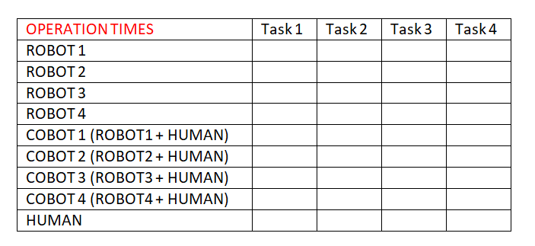
OPERATION TIME
Is assumed to be in minutes and the data type used is integer
Dimension = r X n, where
r = (number of robots * 2) + 1
n = number of tasks

Slide 6
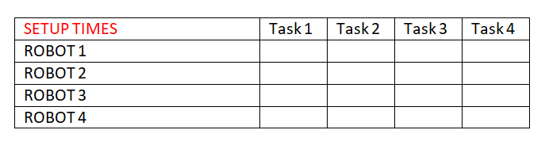
SETUP TIME
Is assumed to be in minutes and the data type used is integer
Dimension = r X n, where
r = number of robots
n = number of tasks

Slide 7
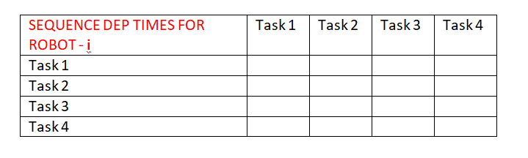
SEQUENCE DEPENDENT TIME
Is assumed to be in minutes and the data type used is integer
Dimension = r X [ n X n ], where
r = number of robots
n = number of tasks

Slide 8
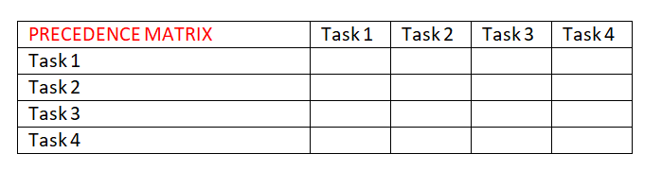
PRECEDENCE MATRIX
The data in this matrix is either 0 or 1 where 0 means no precedence relation and vice versa.
Dimension = n X n, where
n = number of tasks

Slide 9
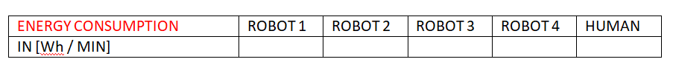
ENERGY CONSUMPTION
The data is in from or array where the energy consumption per min of robots and the human is given. Data type used is double.
Dimension = 1 X (r+1) where
r = number of robots

Slide 10
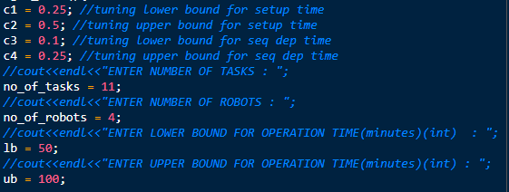
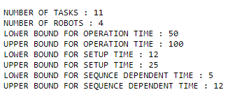
RESULTS OBTAINED FROM THE DEVELOPED CODE

Slide 11
